Slide 1
K19_Front Wheel Rim Approval Test Report
Test Report No. | ABR-C01-011077
Test request Details | 2023-62651
Test request by | Prathamesh P. Kumbhar
Project Code, Project Stage | K19, Production
Part No. | DH151077/03
Report Date | 27-JUNE-2023
Conducted By | Anuj / Gauri / Nikita
Report Prepared By | Gauri / Nikita
Checked & Approved by | Mehul B Champaneria
Test duration | --
Test Status
✓

Slide 2
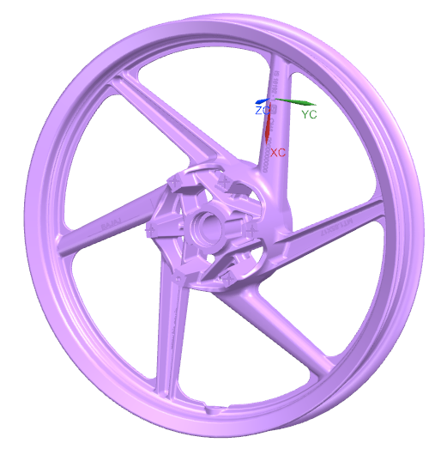
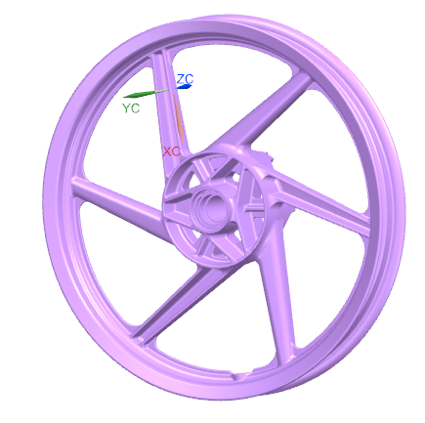
Executive Summary :
Objective of test:
Approval test for newly developed Micro Turner make front wheel rim for K19 vehicle. These wheels are received first time from Micro Turner as a alternate source.
Test standard:
ABS00036_01.
Test Sample Details:
Front wheel rim: (DH151077/03)
 | Description | Front Wheel Rim
Rim | Make & size | MICRO TURNER / 1.85X17”
 | Date/Die code/Mfg. Batch | NOT PROPERLY VISIBLE
Tyre | Make & Size | MRF / 80/100-17”
 | Static load radius (mm) | 280
 | Max load capacity (kg) | 170
 | Tyre pressure @ cold condition (kpa) | 230

Slide 3
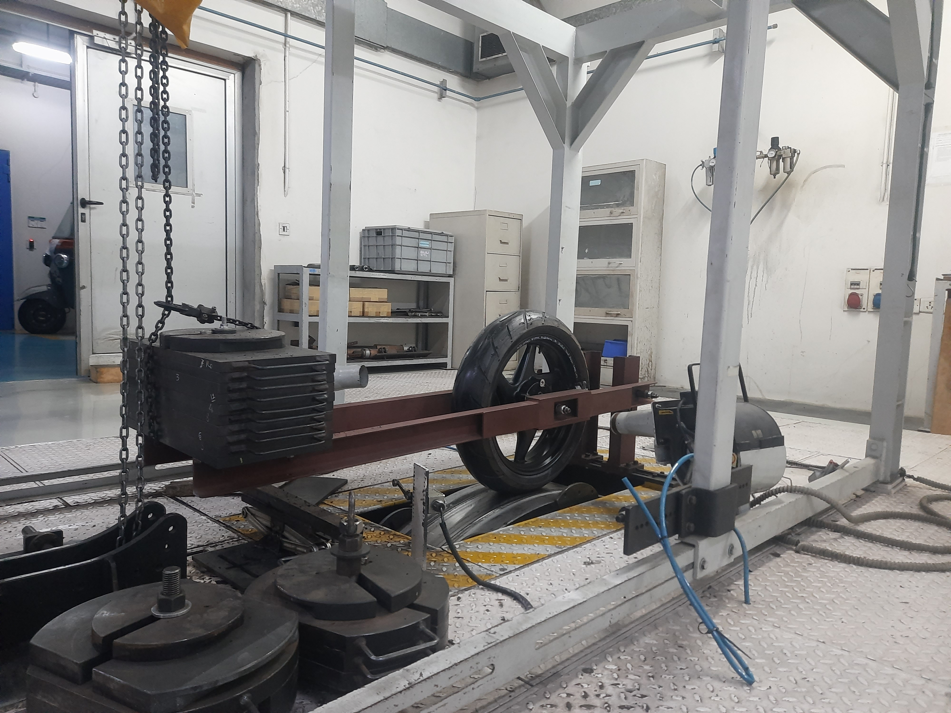
Test Results & Observation: Radial load durability test
Test Condition:
Ref. Test setup photo:
Wheel clamped in fixture
Description | Front Wheel Rim
Wheel Speed (kmph) | 50
Tyre Pressure (kg/cm2) | 2.34
Radial Load (N) | 3752.3
Test Duration (Cycles) | 8 Lac
Test Result:
Dead weight
Sample No. | Acceptance criteria | Axial run out (mm) |  |  |  | Radial run out (mm) |  |  |  | Observation
 |  | Before Test |  | After test |  | Before Test |  | After test
 |  | Disc Side | Oppo. Side | Disc Side | Oppo. Side | Disc Side | Oppo. Side | Disc Side | Oppo. Side
FRONT WHEEL RIM
1 | There should be no evidence of harmful cracks, significant deformation or any abnormal looseness at joints of the wheel. | 0.30 | 0.29 | 0.30 | 0.28 | 0.05 | 0.06 | 0.05 | 0.14 | Sample meet acceptance

Slide 4
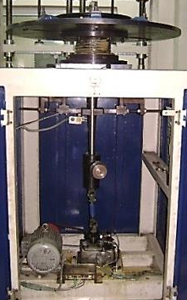
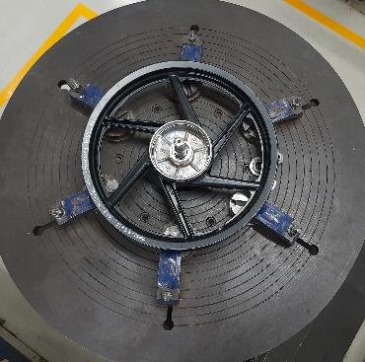
Test Results & Observation: Radial load durability test
Test Condition:
Ref. Test setup photo:
Description | Front Wheel Rim
Bending moment applied (N-m) | 228.8
Test Duration (Cycles) | 1,60,000
Wheel clamped on bed
Eccentric weight
Test Result:
Sample No. | Acceptance criteria | Axial run out (mm) |  |  |  | Radial run out (mm) |  |  |  | Observation
 |  | Before Test |  | After test |  | Before Test |  | After test
 |  | Disc Side | Oppo. Side | Disc Side | Oppo. Side | Disc Side | Oppo. Side | Disc Side | Oppo. Side
FRONT WHEEL RIM
1 | There should be no evidence of harmful cracks, significant deformation or any abnormal looseness at joints of the wheel. | 0.38 | 0.34 | 0.42 | 0.32 | 0.16 | 0.13 | 0.16 | 0.12 | Sample meet acceptance
2 |  | 0.30 | 0.37 | 0.74 | 0.59 | 0.10 | 0.15 | 0.12 | 0.14 | Sample meet acceptance

Slide 5
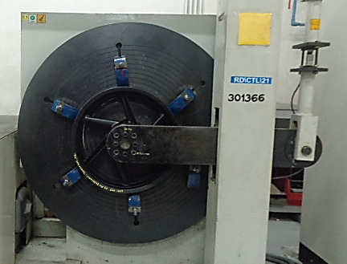
Test Results & Observation: Radial load durability test
Test Condition:
Ref. Test setup photo:
Description | Front Wheel Rim
Test Speed (RPM) | 120
Torsion moment applied (Nm) | 467.0
Test Duration (Cycles) | 1,60,000
Wheel clamped
M/c arm connected to brake mounting area through fixture
Test Result:
Sample No. | Acceptance criteria | Axial run out (mm) |  |  |  | Radial run out (mm) |  |  |  | Observation
 |  | Before Test |  | After test |  | Before Test |  | After test
 |  | Disc Side | Oppo. Side | Disc Side | Oppo. Side | Disc Side | Oppo. Side | Disc Side | Oppo. Side
FRONT WHEEL RIM
1 | There should be no evidence of harmful cracks, significant deformation or any abnormal looseness at joints of the wheel. | 0.58 | 0.42 | 0.56 | 0.44 | 0.16 | 0.17 | 0.15 | 0.12 | Sample meet acceptance
2 |  | 0.53 | 0.50 | 0.70 | 0.57 | 0.16 | 0.07 | 0.22 | 0.07 | Sample meet acceptance

Slide 6
Test Conclusion:
K19_Micro Turner front wheel rim sample 1 meet acceptance criteria of Radial load durability test as per ABS00036_01 standard.
K19_Micro Turner front wheel rim sample 1 & sample 2 meet acceptance criteria of Cornering fatigue test as per ABS00036_01 standard.
K19_Micro Turner front wheel rim sample 1 & sample 2 meet acceptance criteria of Torsion fatigue test as per ABS00036_01 standard.

Slide 7
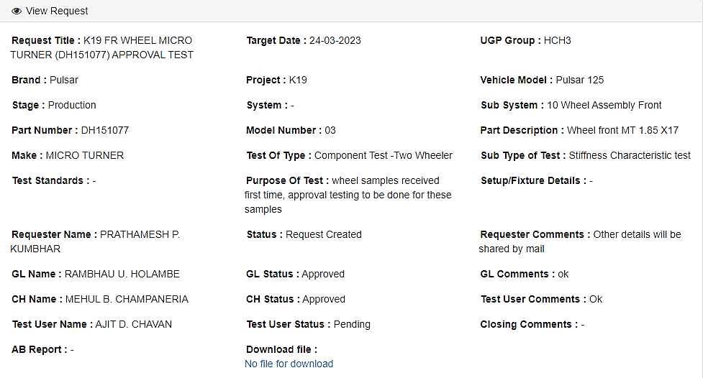
Test Request Details:
Sheet no - 7

